Slide 1
Women’s Taster Class
Wifi password: j4cks0n5
Join the group chat here: http://bit.ly/2yvqvUg
by CodeYourFuture

Slide 2
Who is CodeYourFuture?

Slide 3
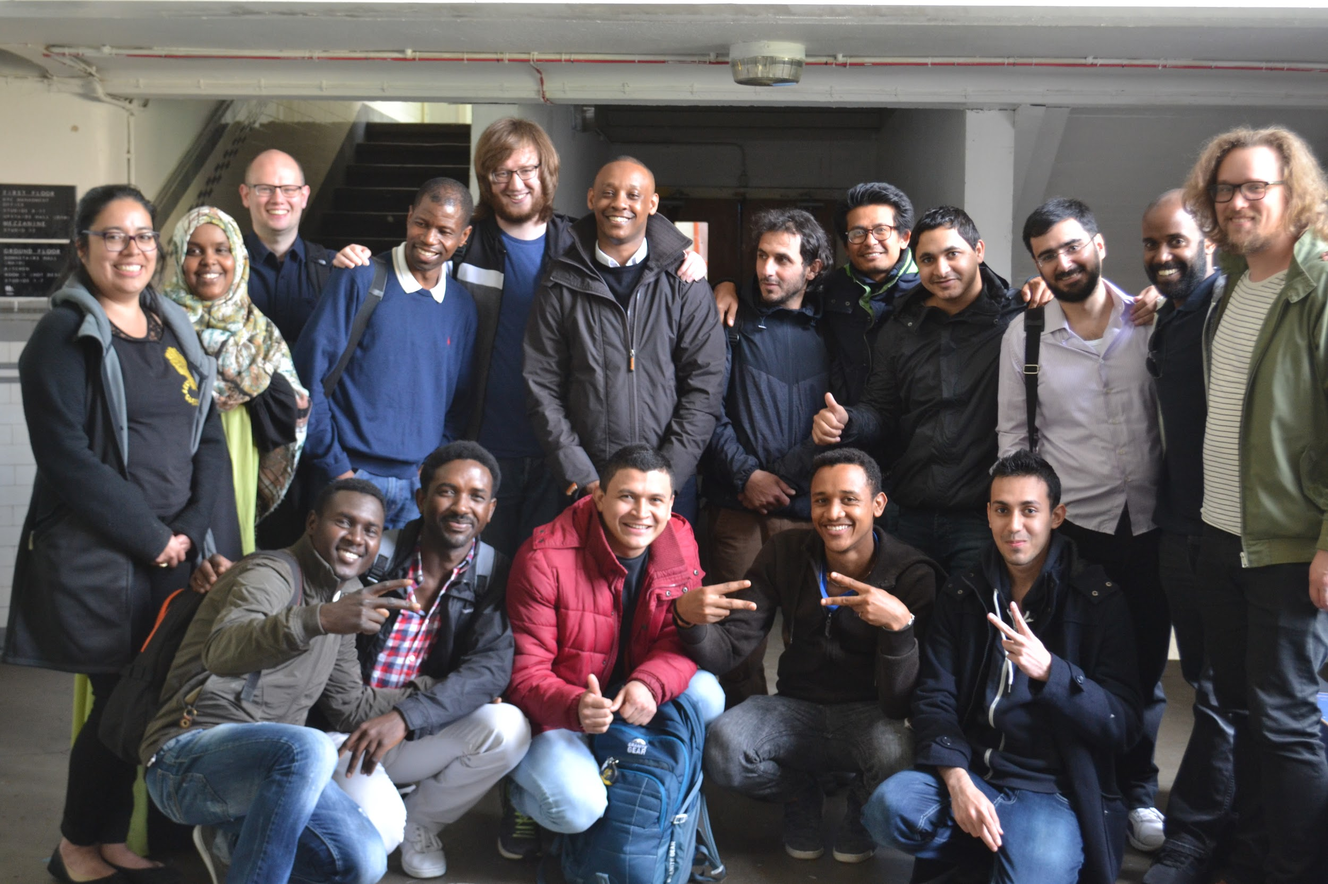
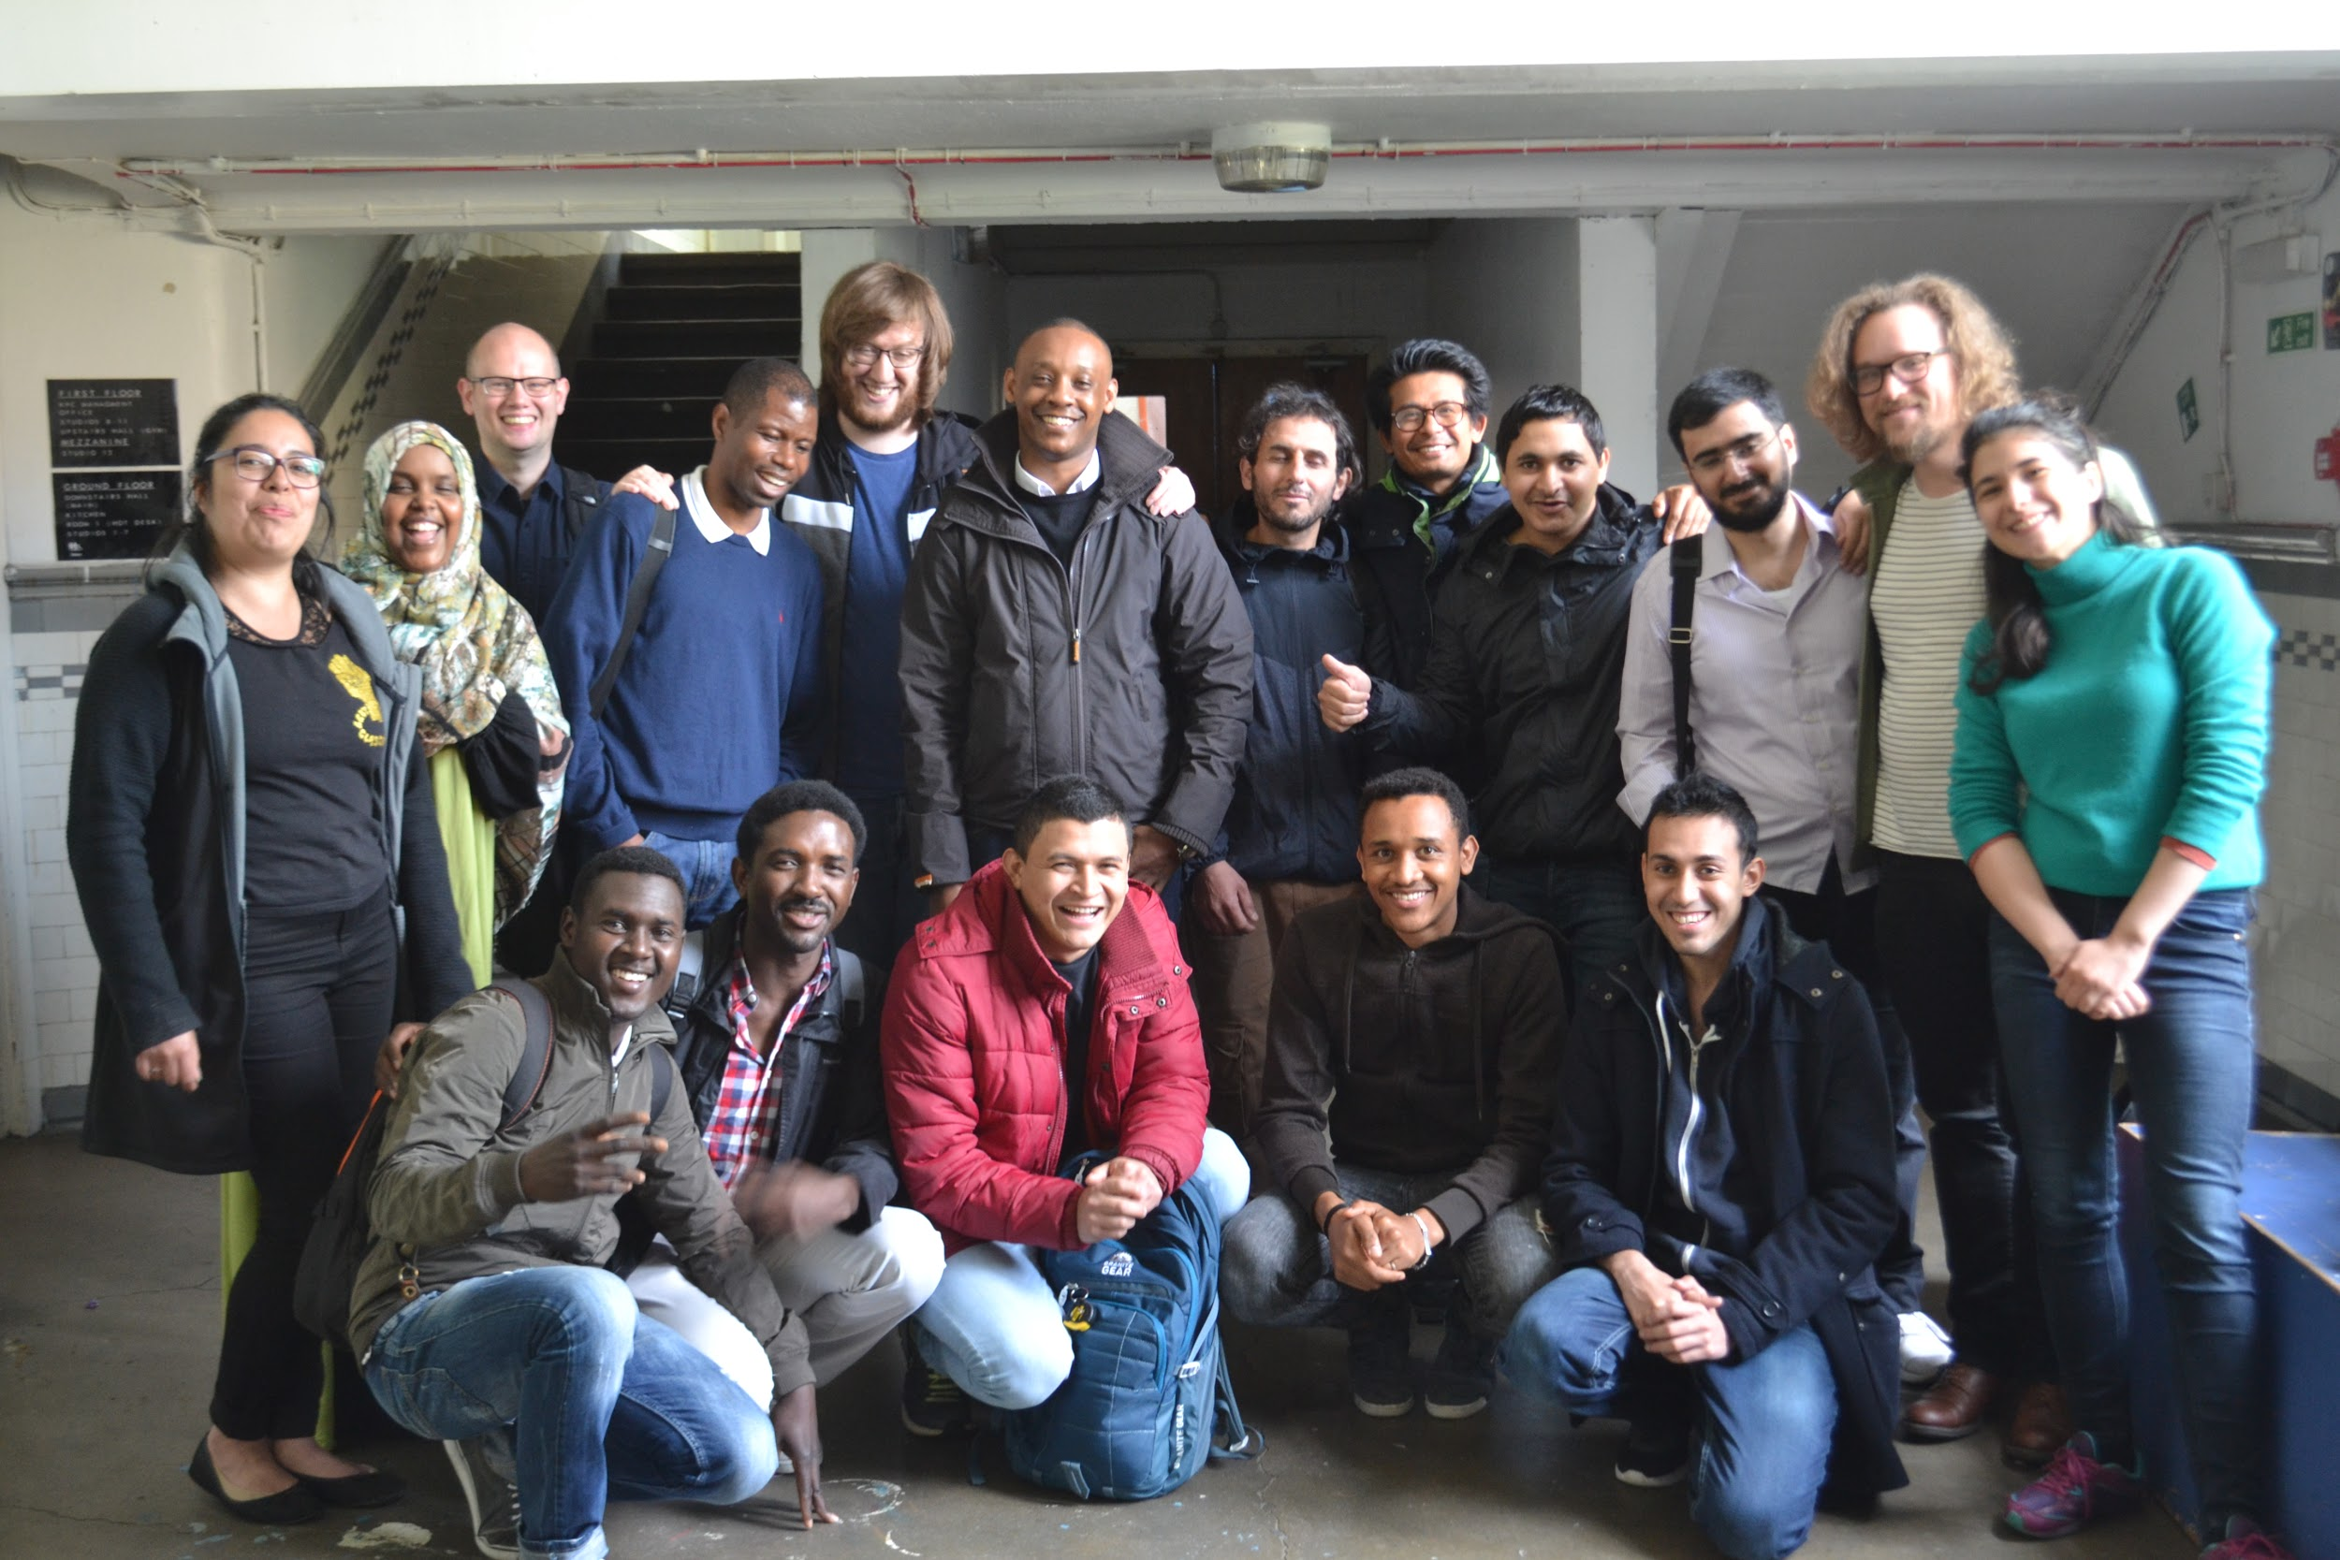

Every Saturday Kinning Park 10am-5pm Complex
Notes:
CodeYourFuture is a school run entirely by volunteers that teaches programming (web development specifically) to refugees and asylum seekers in the UK in a 6 months program that aims to give them the skills to have their first job in Tech by the end of the course. We teach through mentorship and hands-on instruction. This idea expanded from a school set up in London last year, where students that finished the course were able to find jobs in places like the Financial Times and We-love-digital. Our first class in Scotland started in April and are finishing this month, we’ll be hosting their graduation party soon.

Slide 4
CodeYourFuture
We hold 6-month web development classes
Our next class starts in January
We help with transportation and childcare costs
Everyone is welcome to apply
London, Glasgow & Manchester
Notes:
Our next class starts in January and we’ve started accepting applications. If you’re interested please contact us. Everyone is welcome at our classes. We focus mainly on providing classes for refugees and asylum seekers. But we also have a couple of places on it for non-refugees or asylum seekers, as we recognise the many barriers that keep people from expanding their learning and find meaningful work. We also believe in making an inclusive community of people as much as possible, where can all learn from each other even when coming from different walks of life.

Slide 5
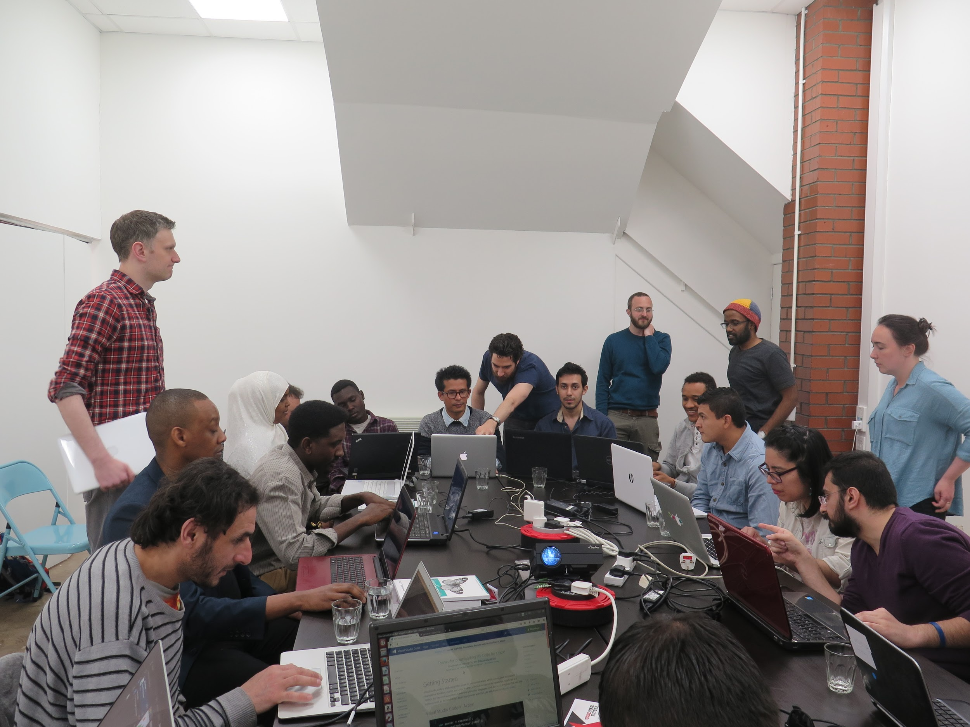
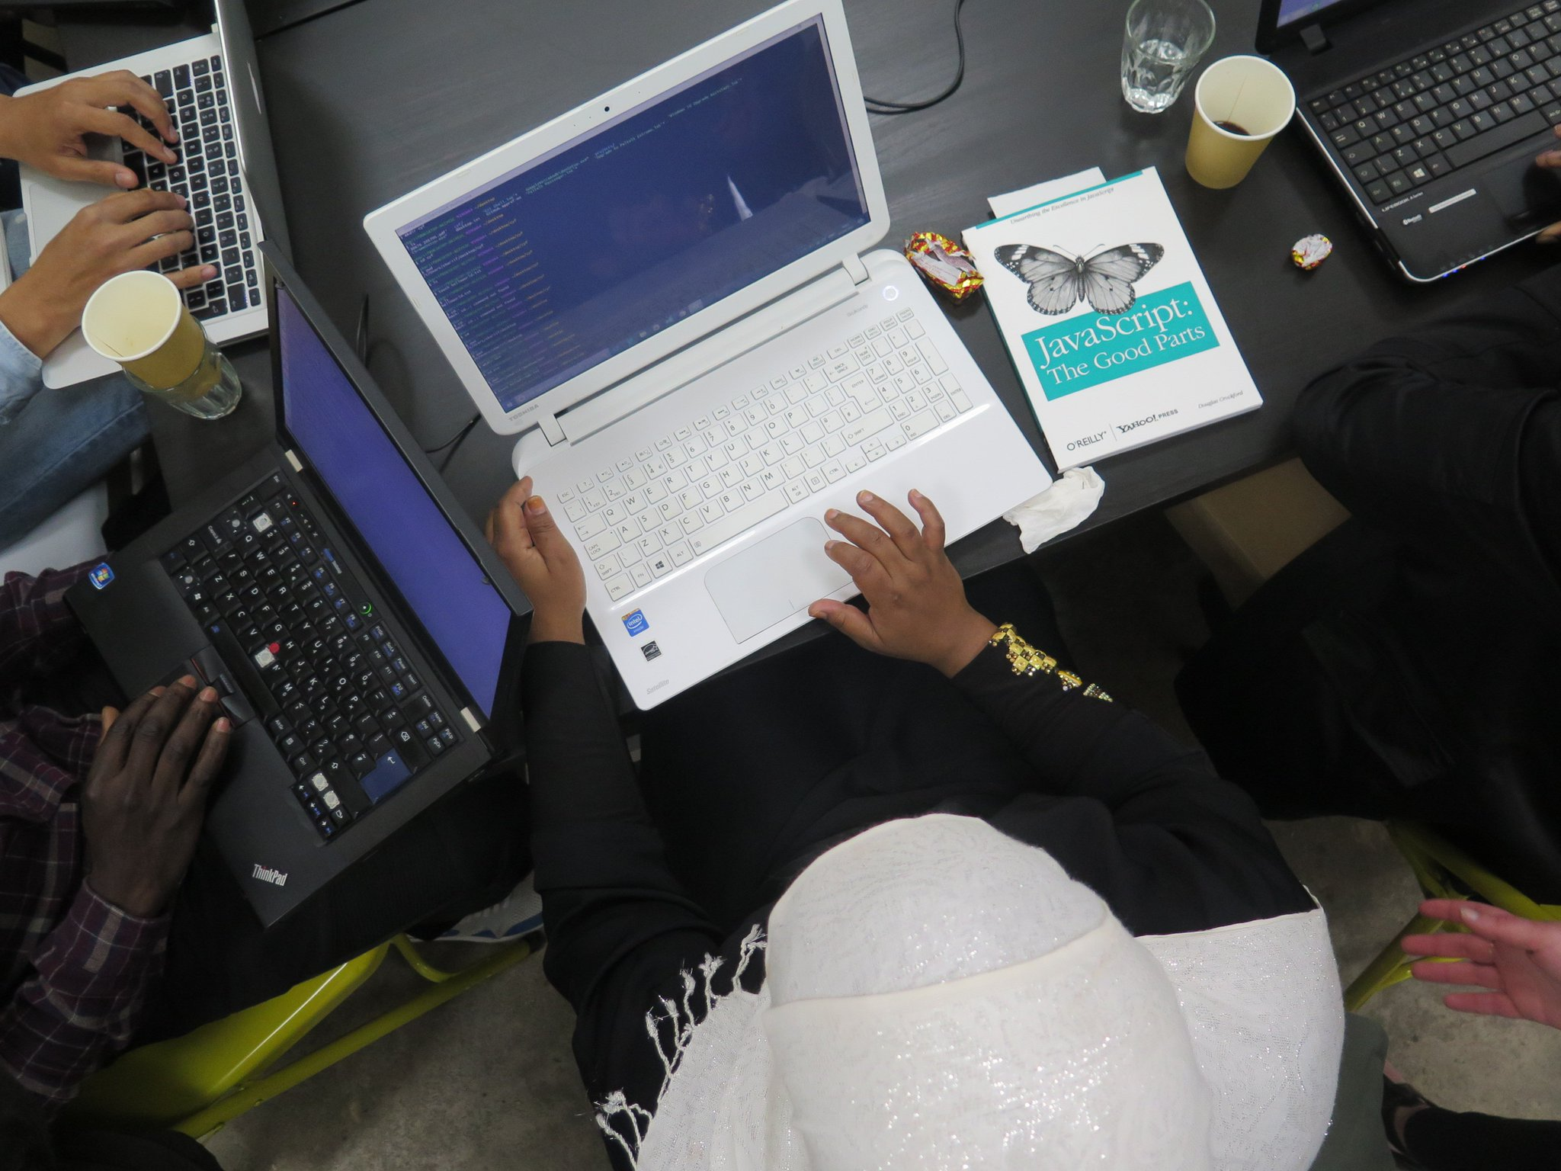
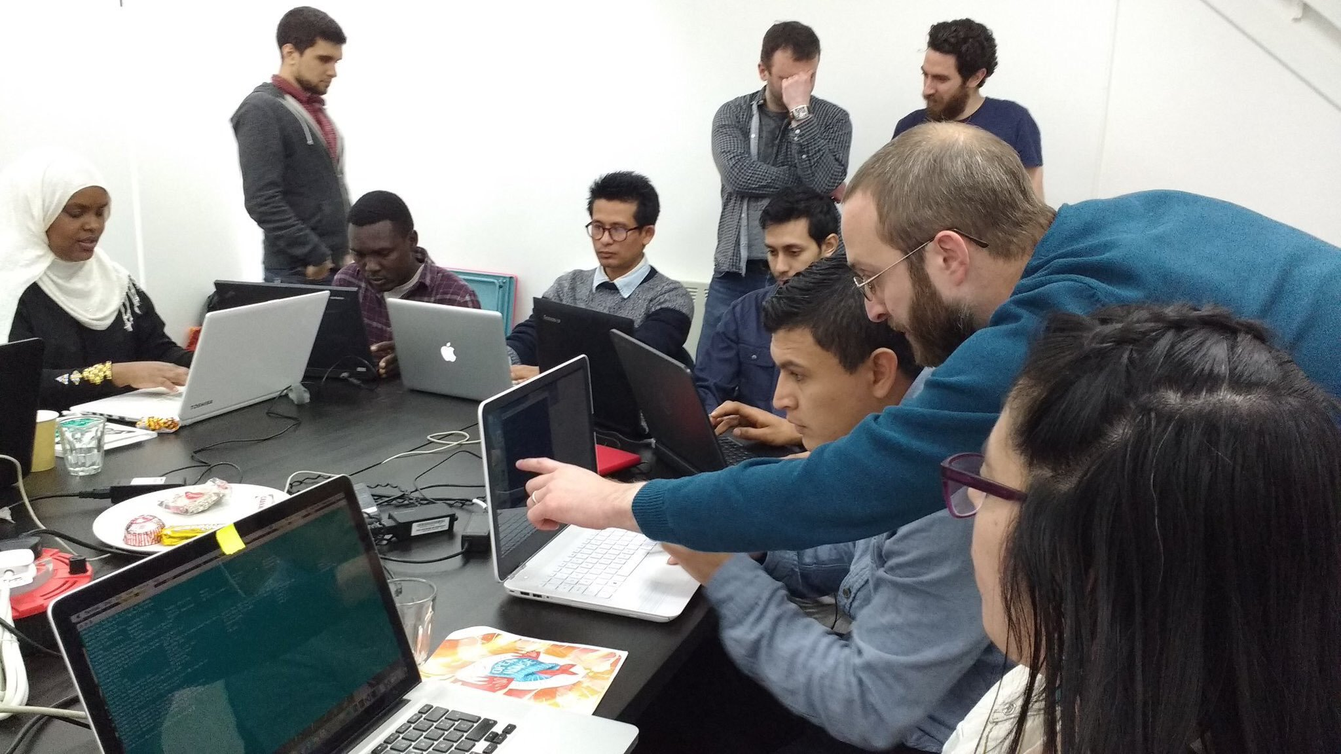
How we teach
How we teach
Light on lectures
Big on exercises
Lots of mentors
Students helping students
Get away from the screen

Slide 6
Why have a Women’s Taster Class?
Notes:
A very short talk about this before we head directly into the code.

Slide 7
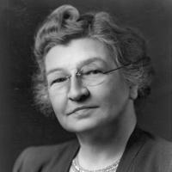
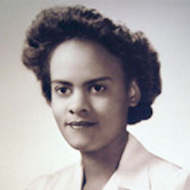
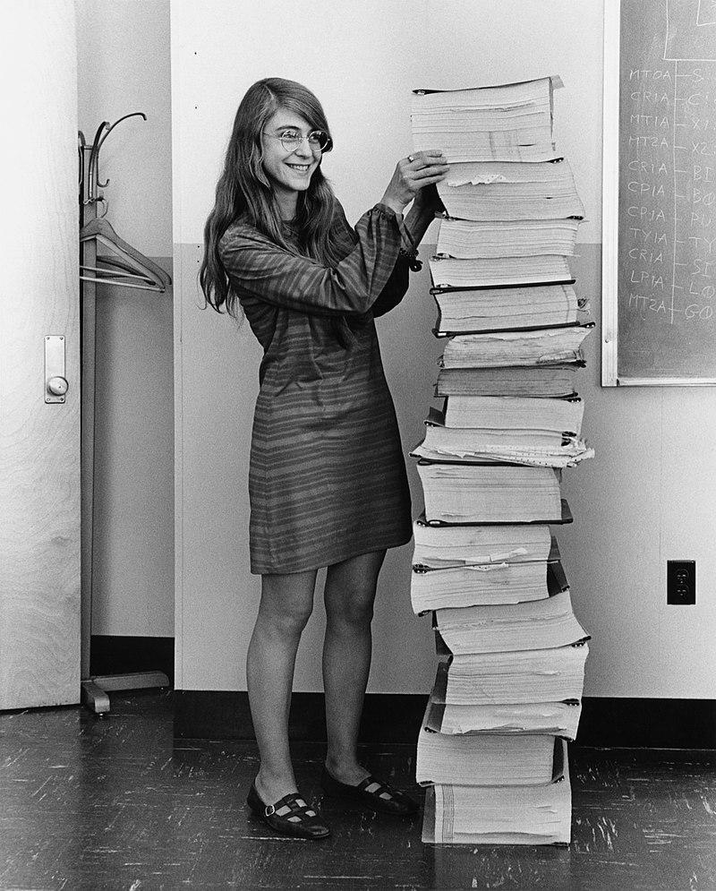
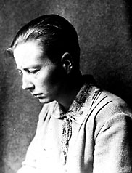
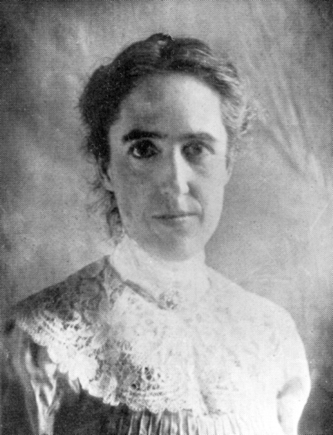
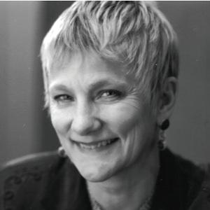
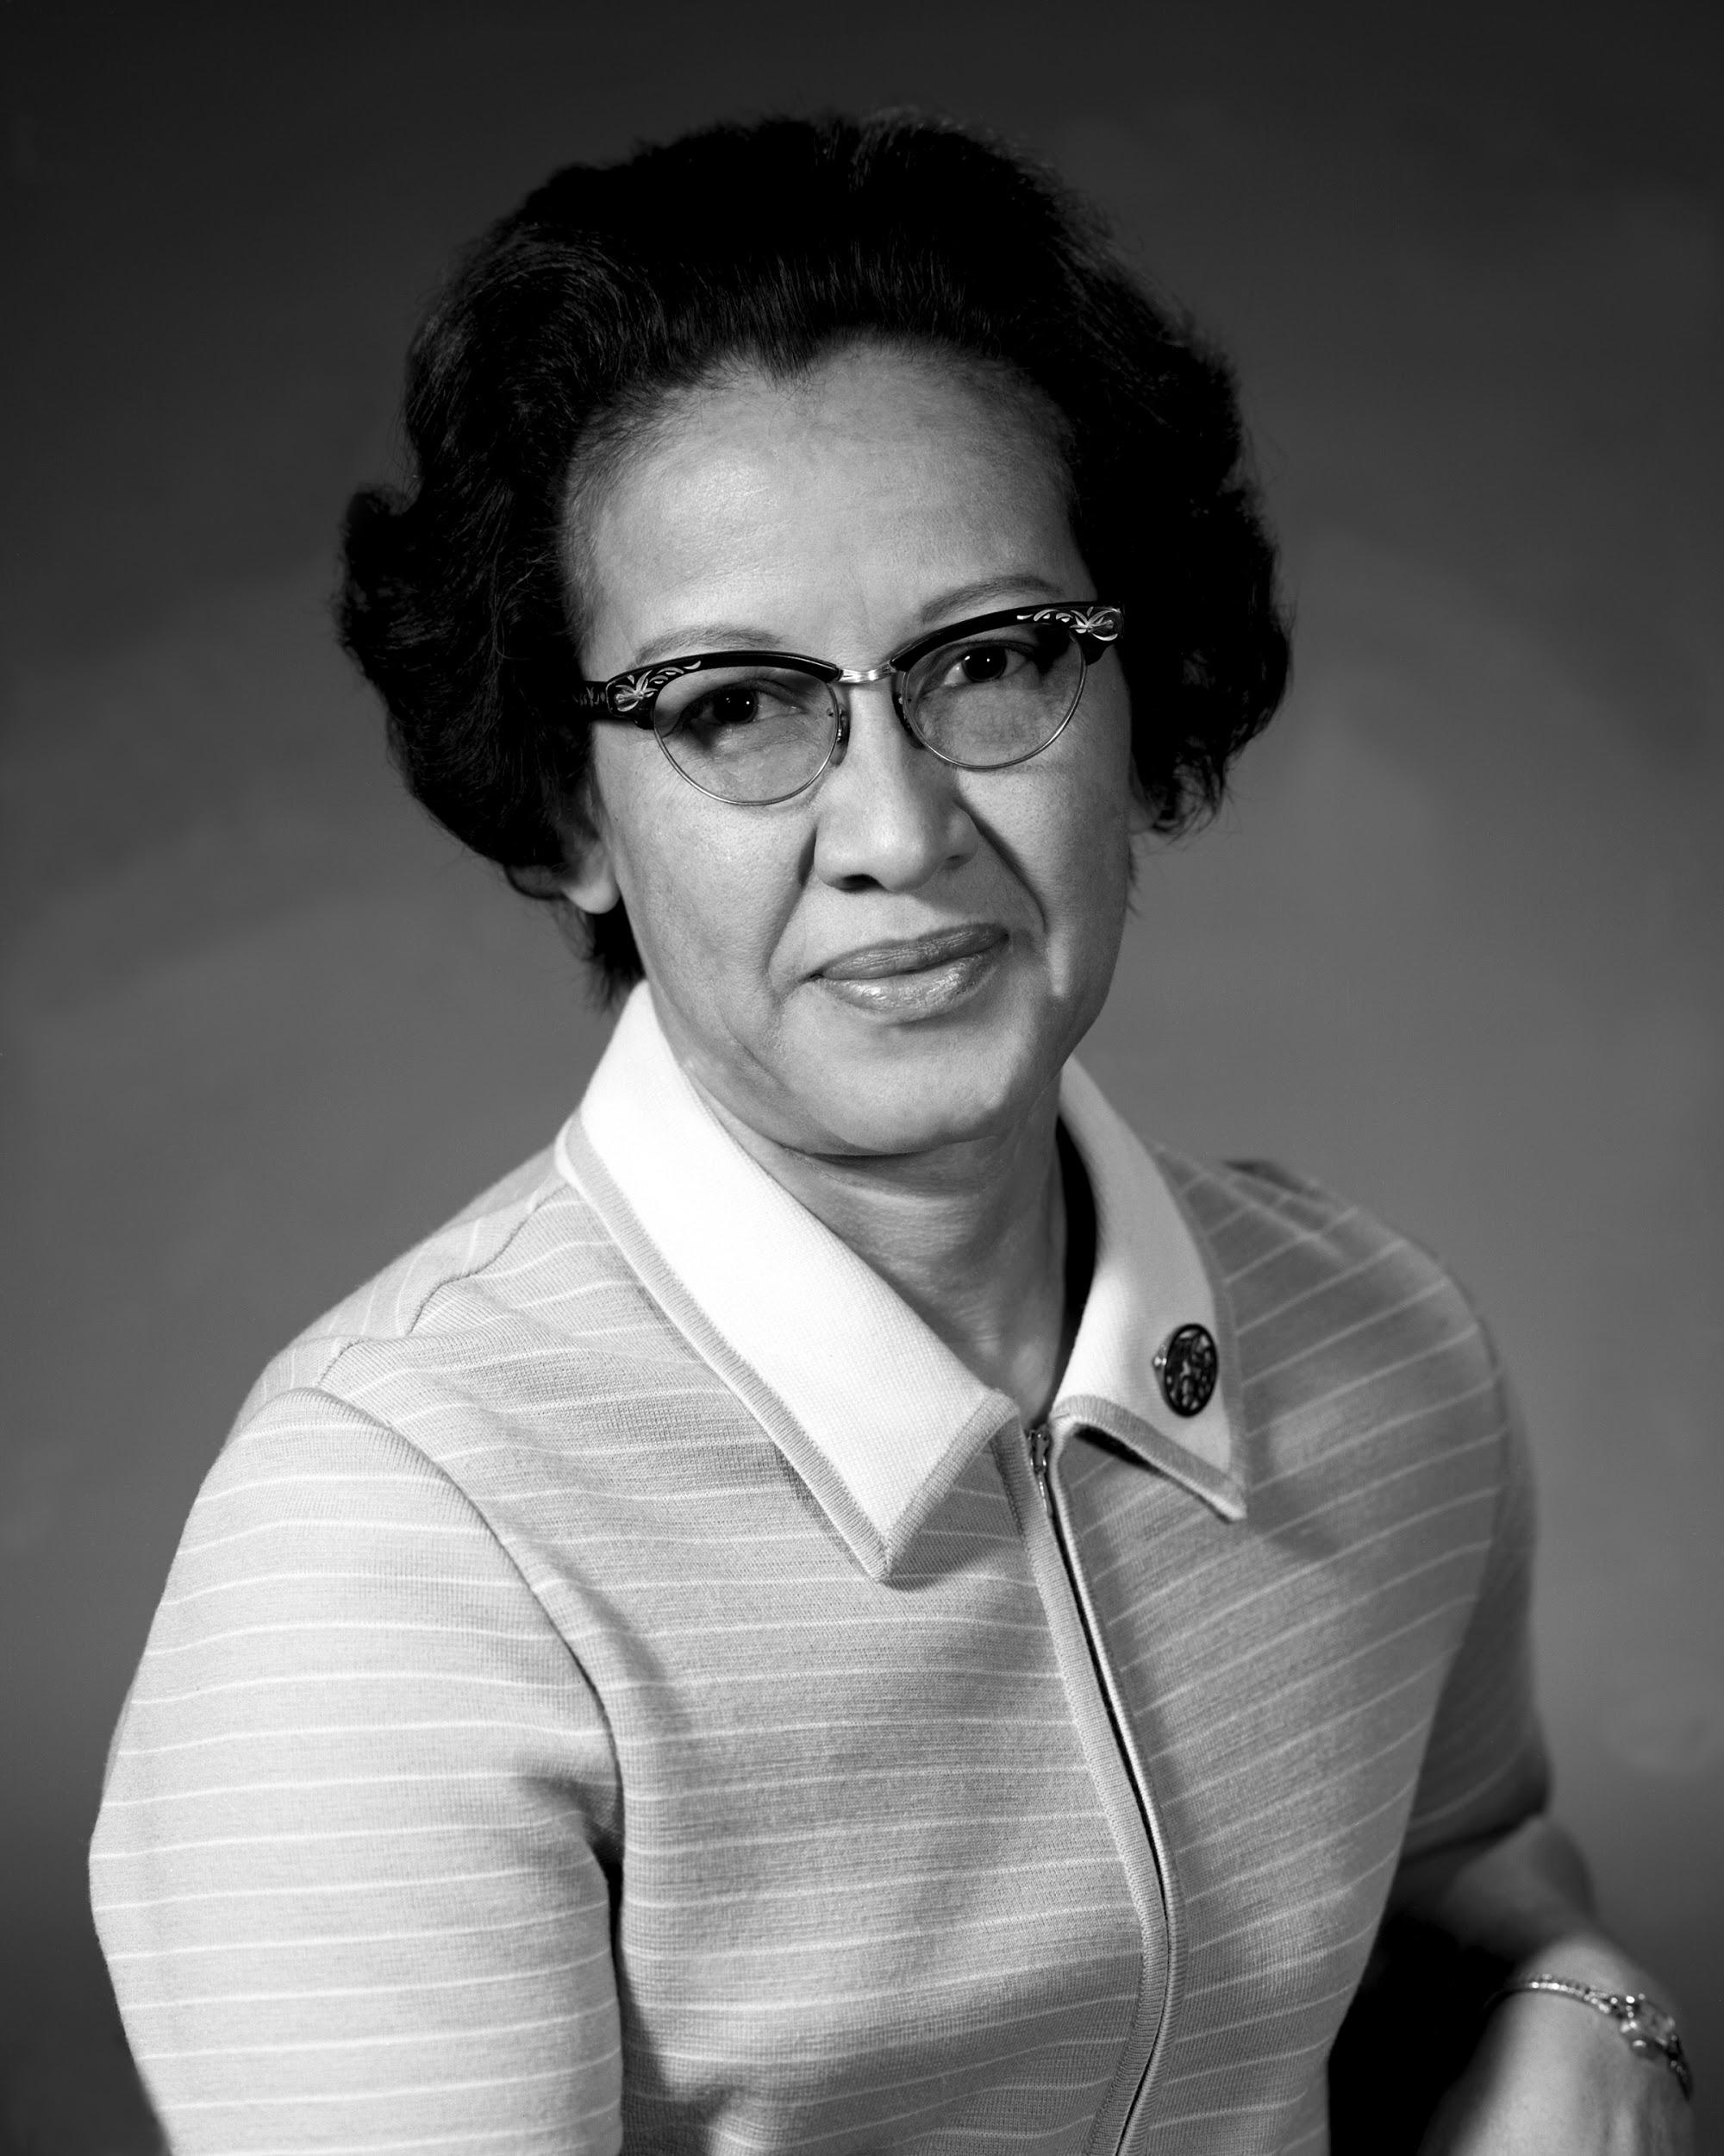
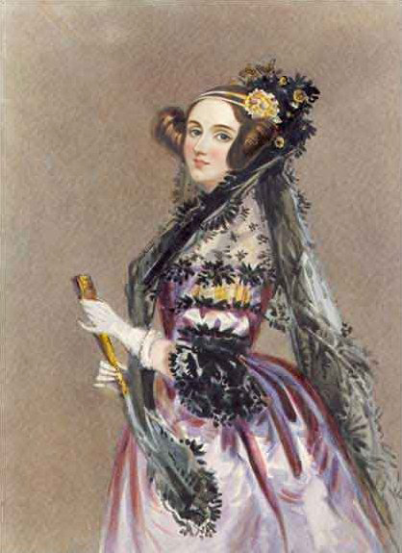
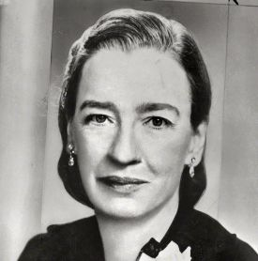
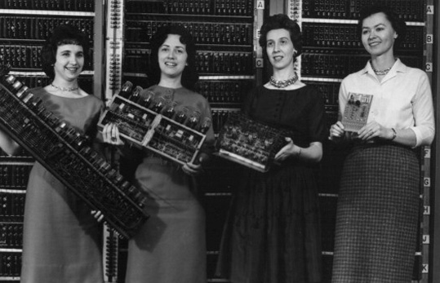
The Forgotten Female Programmers That Shaped Modern Tech
Notes:
Edith Clark, Margaret Hamilton, Grace Hopper, Ada Lovelace, the ladies of Eniac, etc.

Slide 8
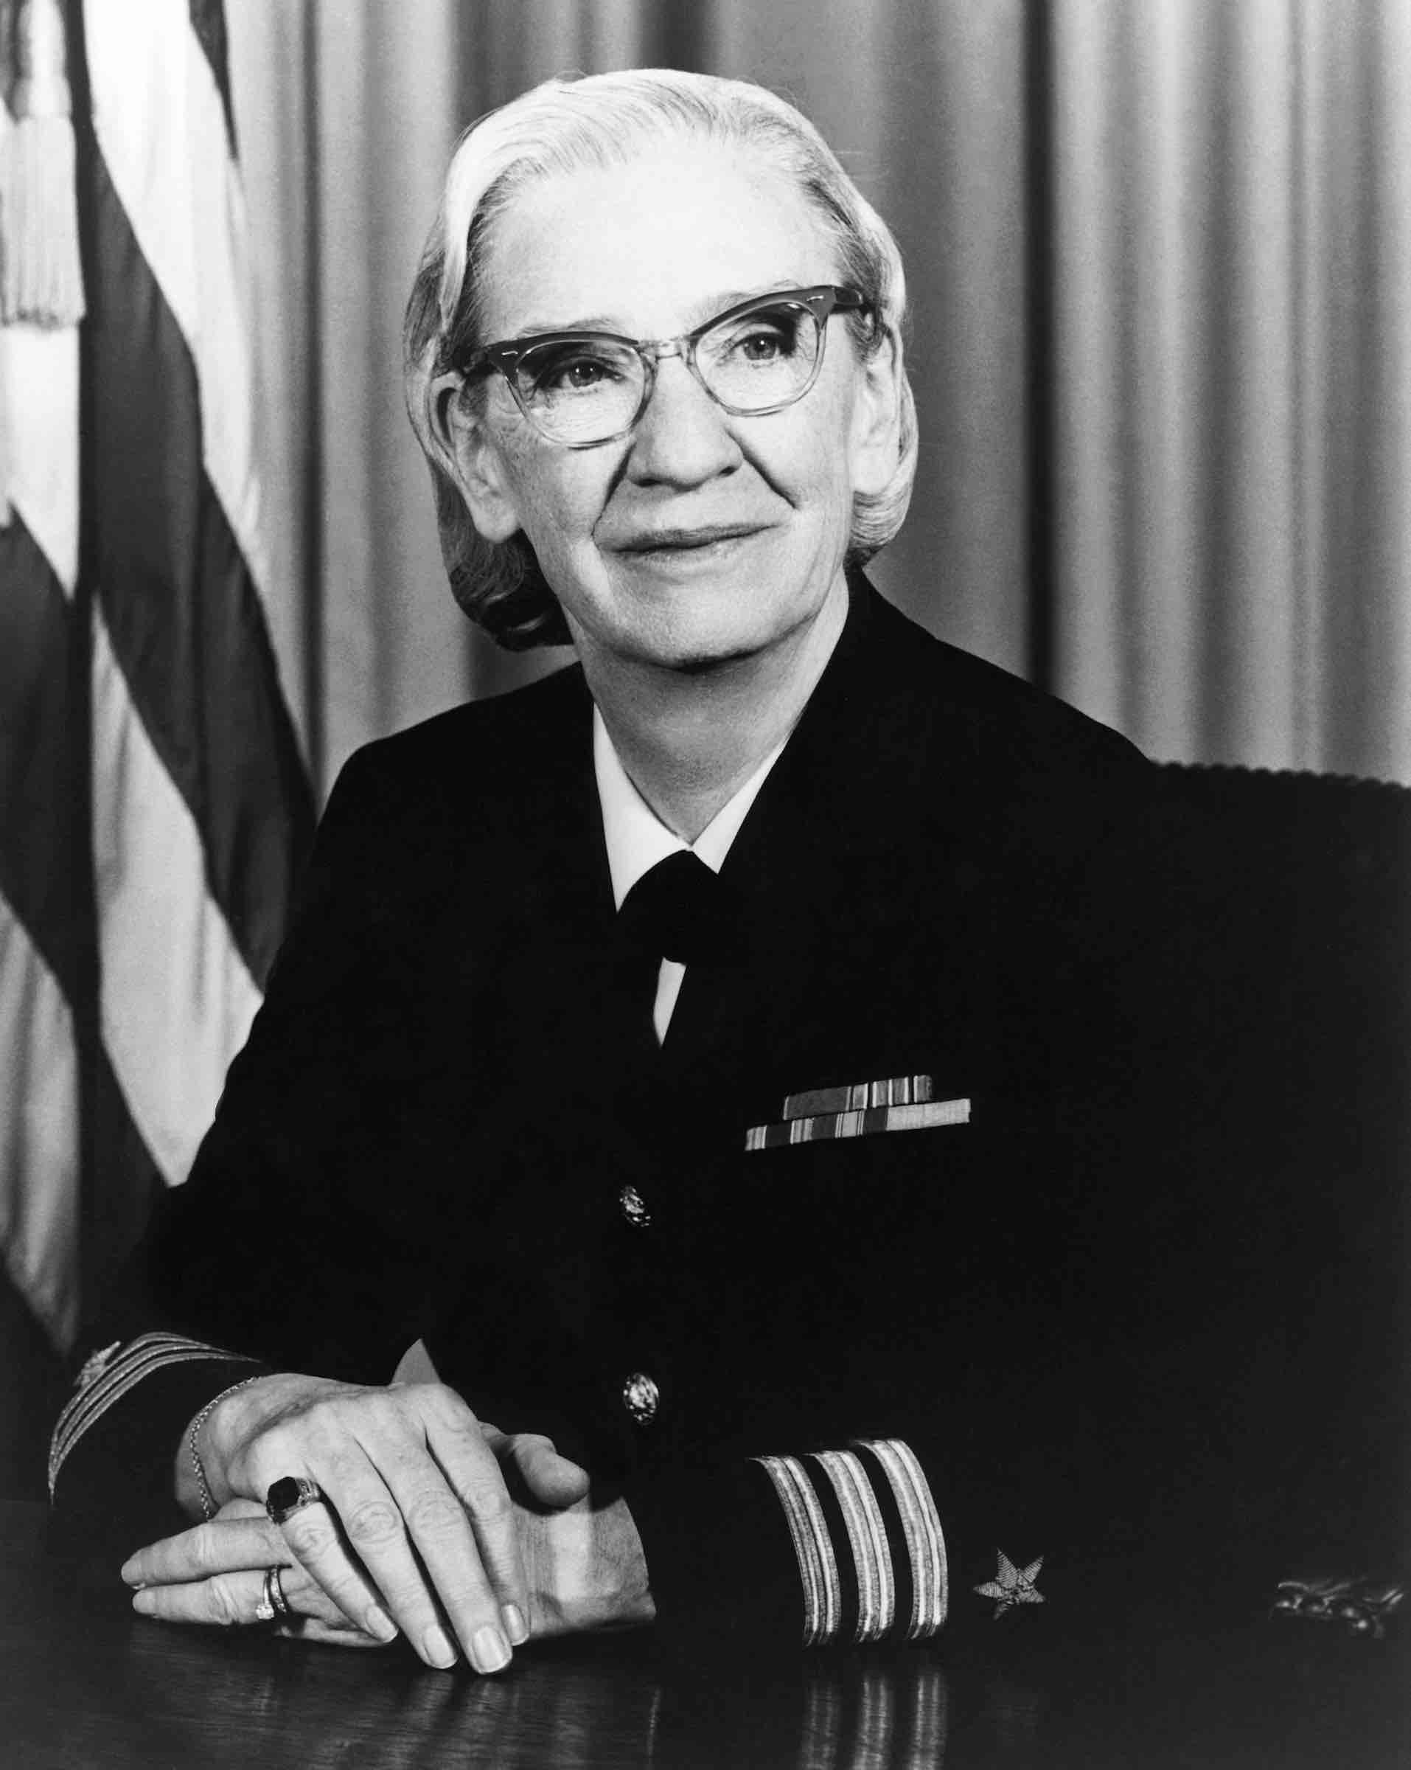
Grace Hopper
Was a pioneer computer scientist.
Developed the first compiler for a programming language.
Pushed for programming languages to be human readable, not just 1’s and 0’s.
She received the Presidential Medal of Freedom and over 40 honorary degrees from universities across the world.
“I had a running compiler and nobody would touch it. They told me computers could only do arithmetic.”
Notes:
Grace Hopper for example was an absolute legend. She was an American computer scientist (who also happened to work in the United States Navy). She was a pioneer of computer programming, . While compilers are indispensable to programmers today, they were revolutionary at a time when computers were mainly used, as their name implies, for performing computations: “Nobody believed that,” she said. “I had a running compiler and nobody would touch it. They told me computers could only do arithmetic.” Eventually her work there was recognized and she was rewarded for her work. Also, her belief that programming languages should be as easily understood as English was highly influential. It is largely due to Grace Hopper’s influence that programmers use understandable code instead of 1s and 0s today. And that we are able to do so much while writing so little.

Slide 9
The Forgotten Female Programmers That Shaped Modern Tech
Notes:
Grace Hopper is one of many pioneering women in CS … but there is something strange about how little we associate women with computer science, seeing as we have many examples of women contributing significantly.

Slide 10
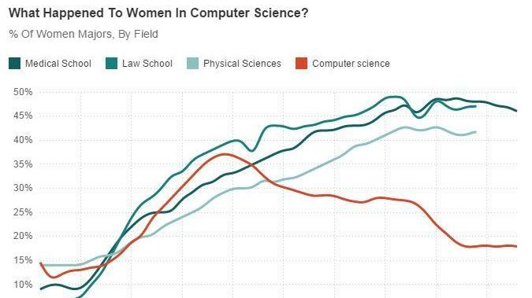
Notes:
Sadly we see a trend that started in 1984 that shows women are less and less represented in tech

Slide 11
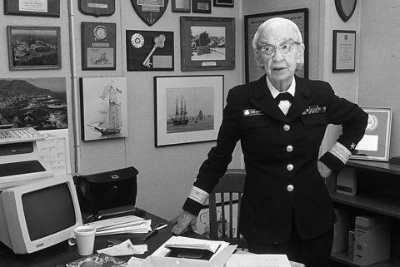
Grace would not be happy about this ...

Slide 12
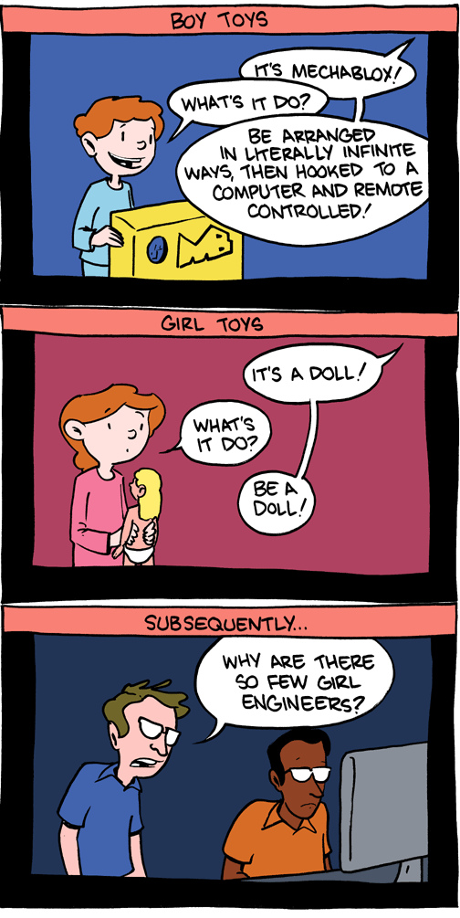
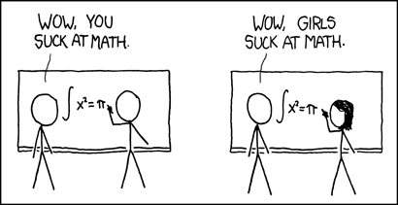
But why is this is happening?

Slide 13
Diversity is important.

Slide 14
Diversity is important.
Women don’t get the opportunity to learn a valuable skill, and something they might find passion for.

Slide 15
Diversity is important.
Women don’t get the opportunity to learn a valuable skill, and something they might find passion for.
Businesses lose out on potential valuable employees, on the wealth of experience and perspective that can be unique to women.

Slide 16
Diversity is important.
Women don’t get the opportunity to learn a valuable skill, and something they might find passion for.
Businesses lose out on potential valuable employees, on the wealth of experience and perspective that can be unique to women.
Technology is becoming an important part of our daily lives, as well as our work. We’re all affected by it, yet leave women out of decision-making.

Slide 17
Diversity is important.
Women don’t get the opportunity to learn a valuable skill, and something they might find passion for.
Businesses lose out on potential valuable employees, on the wealth of experience and perspective that can be unique to women.
Technology is becoming an important part of our daily lives, as well as our work. We’re all affected by it, yet leave women out of decision-making.
The world of technology is left with fewer innovators like Grace Hopper.
...

Slide 18
Why are fewer women in tech?
What can we do about it?
improvements to education
making the business case for more women in tech
creating positive narratives and championing rolemodels
strengthening female networking and mentoring
access to funding
There are no easy answers, but there are some really interesting ideas about why this is the case.
If you want to know more about this, I recommend listening to a radio podcast from NPR called “When Women Stopped Coding.”
https://www.npr.org/sections/money/2014/10/17/356944145/episode-576-when-women-stopped-coding

Slide 19
Now let’s talk code

Slide 20
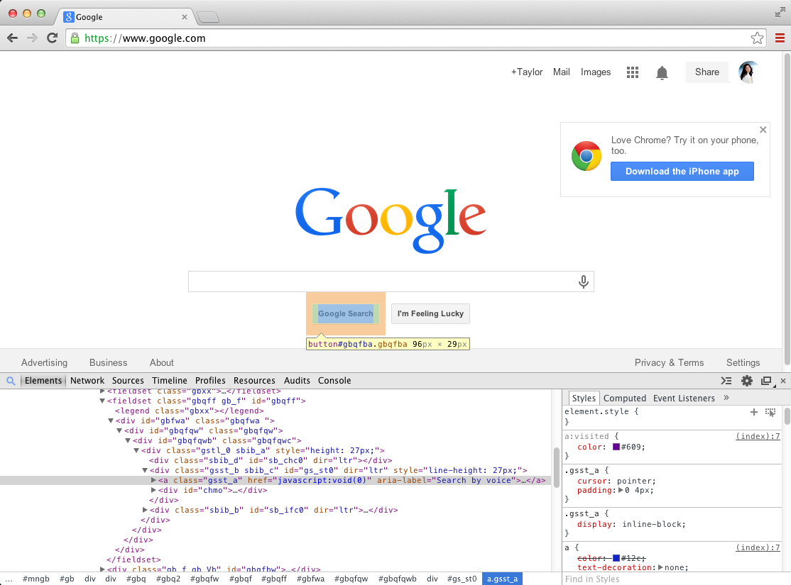
Looking into websites
Go to a website of your choice (BBC News, Twitter, etc)
Right-click on an element of the website and select “Inspect”
Now replace the text of the element you chose with a text of your choosing (it can be anything)
Notes:
{I found that using Developer Tools to inspect everyday websites people us is a great way to break the barrier of learning code: you can go to any website, look at its code, modify it, copy it, remix it and so on. It can be quite a fun experiment with participants often enjoying modifying BBC headlines and tweets and screenshotting them}

Slide 21
HTML & CSS
Notes:
HTML and CSS are the two languages we use together to structure and style webpages. Pretty much everything on the web uses HTML and CSS to some degree. From simple websites to huge and complex web applications, like Pinterest and Twitter.

Slide 22
Anatomy of a website
Your Content
+ HTML: Structure
+ CSS: Presentation
= Your Website
A website is a way to present your content to the world, using HTML and CSS to present that content & make it look good.

Slide 23
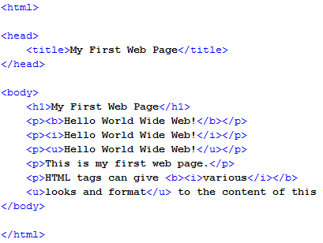
HTML (Hypertext Markup Language)
HTML is the skeleton behind every website
It provides the basic structure, telling the browser where everything should go
It uses tags to say what type of elements we want to add (e.g. a ‘p’ tag is for paragraphs)
Notes:
Every webpage you look has some HTML code. You can think of HTML as the skeleton that gives every webpage structure. HTML, which stands for hypertext markup language, is simply a set of tags we use to describe to the browser how our webpages are structured. We do this by surrounding the content of our webpages with these HTML tags.
As you can see, all of our content in wrapped in HTML tags. Most tags have an opening tag and a closing tag. HTML tags can have what are called attributes on them like the class attribute on this h1 here. Attributes help us give the browser more information about how the tag should work or look.

Slide 24
Anatomy Of An HTML Element
Element
An individual component of HTML
Paragraph, heading, table, list, div, link, image, etc.
Tag
Marks the beginning & end of an element
Opening tag and Closing Tag
Tags contain characters that indicate the tag's purpose
<tagname>Stuff in the middle</tagname>
E.g.
<p> This is a paragraph. </p>
<h1> This is a heading. </h1>
<div> This is a section. </div>

Slide 25
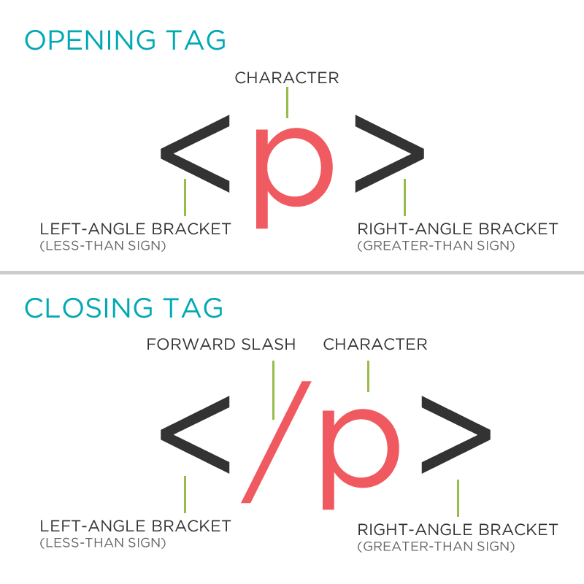
Tag Breakdown

Slide 26
Head and Body Tags
<!DOCTYPE html> <html> <head> <title>Title of the page </title> </head> <body> The page content here. </body> </html>
Head: The head contains the title of the page & meta information about the page. Meta information is not visible to the user, but has many purposes, like providing information to search engines.
Body: The body contains the actual content of the page. Everything that is contained in the body is visible to the user.

Slide 27
Nesting
<!DOCTYPE html> <html> <head> <title>Title of the page </title> </head> <body>
<p> This is a paragraph.
</p> </body> </html>
All elements "nest" inside one another.
Nesting is what happens when you put other containing tags inside other containing tags. For example, you would put the <p> inside of the <body> tags. The <p> is now nested inside the <body>.

Slide 28
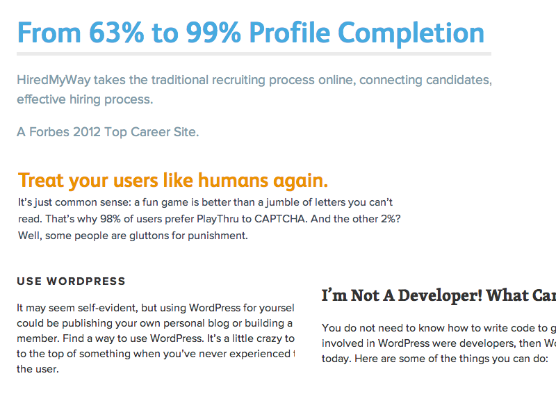
Notes:
Example of how we can organise text using markup, notice the different headers, spacing, etc

Slide 29
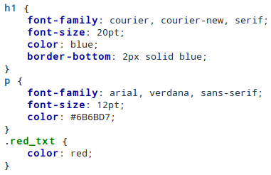
CSS (Cascading Style Sheets)
CSS is a "style sheet language" that lets you style the elements on your page.
CSS works together with HTML.
It deals with the properties of elements (such as colors, position, size, etc.)
Notes:
Then, we use CSS or cascading style sheets to tell the browser what we want the content between the tags to look like. You can think of coding a web page as sort of like making a blueprint for the browser. With your HTML, you're saying hey browser, this particular section of my website is a paragraph. And with CSS, you're saying, hey browser, I want this paragraph's text color to be white and it's background color to be black, and on and on like that. So what can you do with HTML and CSS? You can present a lot of content in well organized and visually appealing ways.

Slide 30
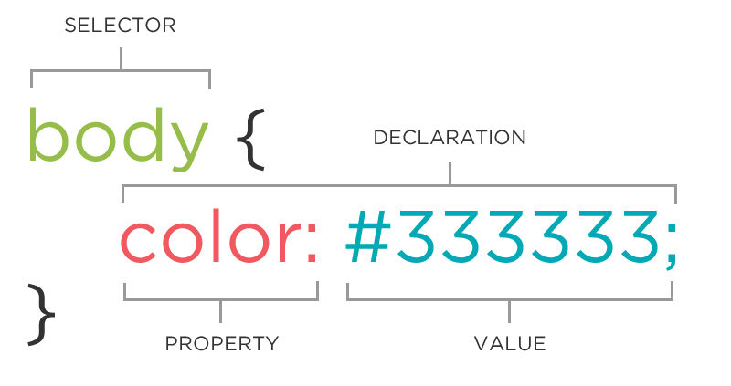
The CSS Rule
Notes:
A block of CSS code is a rule.
The rule starts with a selector.
It has sets of properties and values.
A property-value pair is a declaration.

Slide 31
CSS (Cascading Style Sheets)
body { background-color: yellow;
font-family: Arial, sans-serif;
font-size: 12px;
}
p { color: white; background-color: red; font-type: italic; }
img { width: 200px;
height: 200px;
}
Declarations: Property and value of style you plan to use on HTML element.
Declarations end with a semicolon
Declaration groups are surrounded by curly brackets.
Notes:
Then, we use CSS or cascading style sheets to tell the browser what we want the content between the tags to look like. You can think of coding a web page as sort of like making a blueprint for the browser. With your HTML, you're saying hey browser, this particular section of my website is a paragraph. And with CSS, you're saying, hey browser, I want this paragraph's text color to be white and it's background color to be black, and on and on like that. So what can you do with HTML and CSS? You can present a lot of content in well organized and visually appealing ways.

Slide 32
We’ll now go to codepen.io to get started writing code
Notes:
{we move to codepen and i show them examples of html and css code progressing in difficulty, common examples: paragraphs, divs & spacing; font color; background image} {most of the workshop time is spent here, what is covered is dependent on the audience (what they want to build etc.)}

Slide 33
Thank you!

